Slide 1

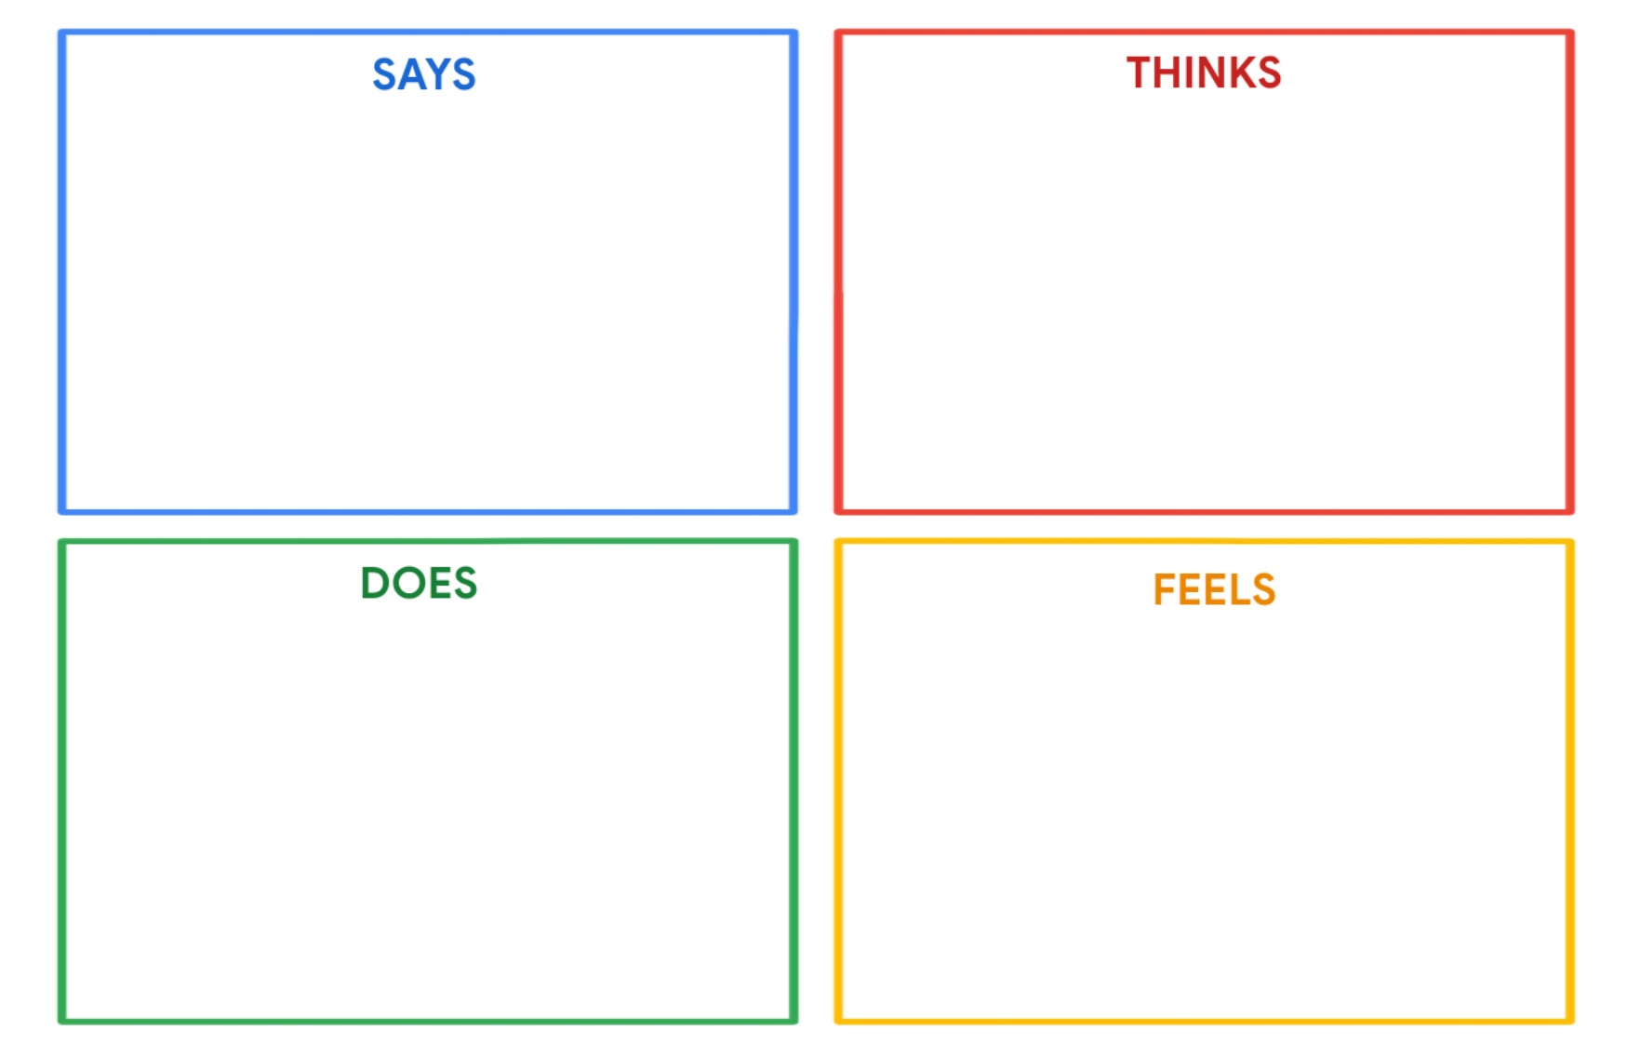
Khalid Mustafa
"I want to become a groundbreaking scientist and change the world."
"I love conducting experiments and learning from them."
"Chess is a fun game that challenges my mind."
"I enjoy reading history books and learning about the past."
"How can I make a significant scientific discovery that impacts the world?"
"I need to master experiments and study in depth to achieve my goal."
"Chess and history books are my escapes and provide mental stimulation."
"I wish there were more advanced challenges to keep me engaged and learning."
Khalid actively conducts experiments and takes notes to learn from them.
He plays chess regularly and may participate in chess clubs or competitions.
Khalid seeks out challenging science and math problems online or from books.
He may express frustration when faced with complex explanations
Khalid is driven and passionate about his goal of becoming a groundbreaking scientist.
He finds joy and fulfillment in conducting experiments and exploring the unknown.
Chess and history books bring him happiness and intellectual stimulation.
He can feel a bit impatient when not presented with advanced challenges.

